Slide 1

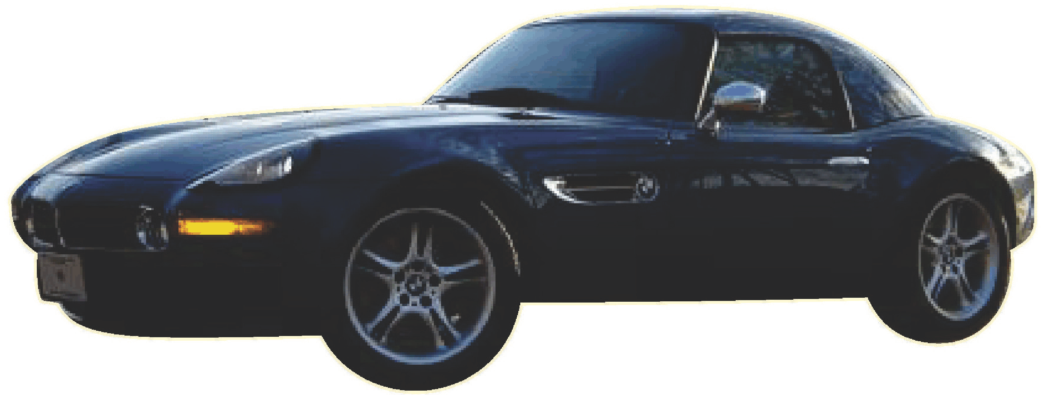

Notes:
America is an automotive society. My autobiography was truly an auto-biography – until I moved here.

Slide 2
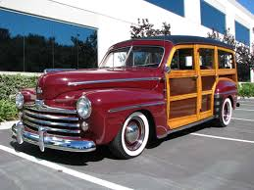
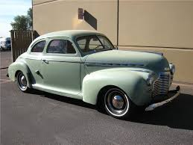
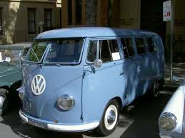
1946 Ford Woody
1941 Chevrolet
1954
VW
Kombi
Notes:
My parents brought me home from the hospital in this 1941 Chevy. My life almost ended in it – I opened the door as my mother was driving across the 10 km long San Francisco Bay Bridge. She couldn't stop – she had to drive with one hand and hold me with the other until she got to the other side.
The first car I remember my parents buying was this used 1946 Ford Woody. They had three kids by that time. It would have been worth a fortune if they hung on to it – surfers were absolutely nuts about them 10 years later – but my dad traded for a more reliable Volkswagen Kombi. It was primitive. No upholstery on the inside, just the metal skin.

Slide 3
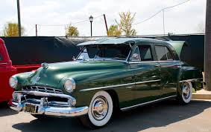
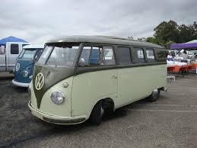
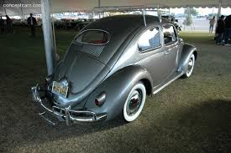
1951 Dodge Sedan
1955 VW Microbus
1957 VW Bug
Notes:
They upgraded to a Microbus, also used, and bought a car like this when my mother started to work. Their first new car was this 1957 Volkswagen. I learned to drive in the Dodge and the Volkswagen, and got my drivers license on my 16th birthday driving the VW

Slide 4
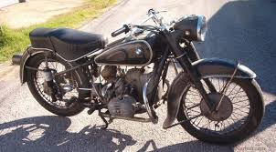
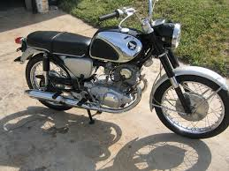
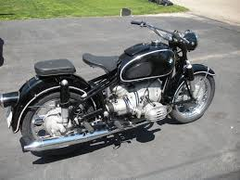
1951 BMW R67
1964
BMW
R60
1964 Honda 305
Notes:
I dropped out of college after 2 1/2 years and bought a Japanese motorcycle. It was not well made. I traded for an older German motorcycle, I replaced with the newer one after a friend wrecked it.

Slide 5
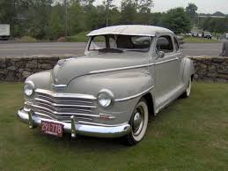
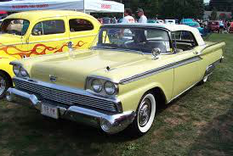
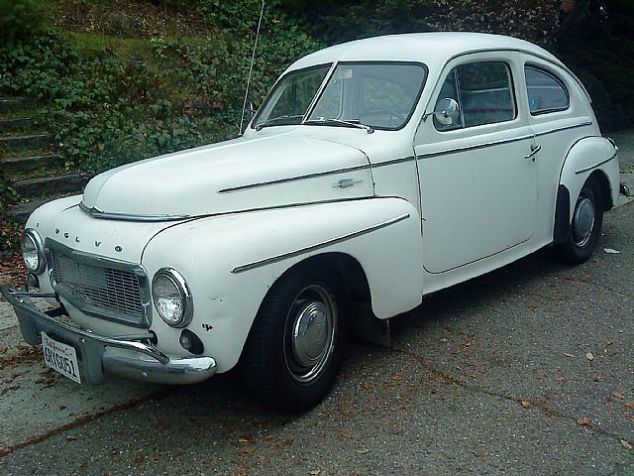
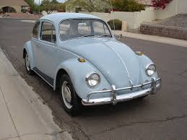
1958 Volvo P544
1967 VW Bug
Notes:
Girls love motorcycles – except when it is cold or rainy. I like girls, so I needed a car. After two false starts, I was driving this Volvo when I finished the University at Berkeley, and bought this Volkswagen, my first new car, when I went to work for IBM. It is the only time I ever borrowed money to buy a car. $90 a month

Slide 6
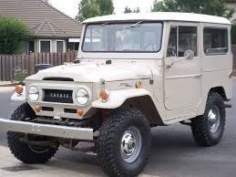
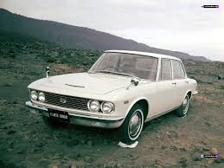
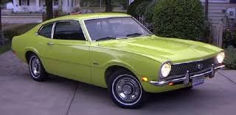
1969 Mazda
1968 Toyota
Land Cruiser
1971 Ford Maverick
Notes:
IBM gave me this Toyota to drive when I went to Danang, Vietnam. I moved down to Saigon after a year and bought this used Mazda. Then, in my first big automotive mistake, I bought this pistachio colored Ford Maverick. The Vietnamese laughed. They knew that the Japanese made better cars. The French laughed at me. "Comment ca va, pistache?" However, in a second mistake one of the Frenchified Vietnamese girls married me despite the car.

Slide 7
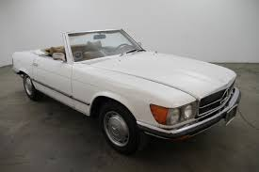
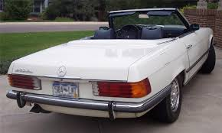
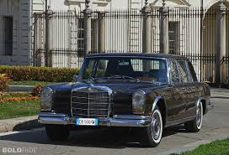
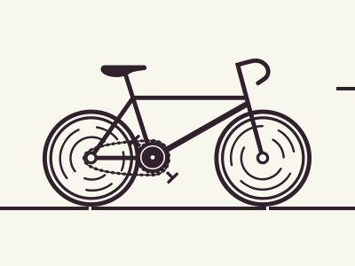
1973 Mercedes 450SL
1966 Mercedes 600
Notes:
Germany autobahns had no speed limits. I bought this fast car when I moved there. Thanks to the magic of exchange rates, I was able to sell it for a profit after owning it for eight years. However, I lost all the money in my second major automotive mistake, buying a 3 ton limousine. I have to assure you that imagining driving a car like this is much more fun than actually being behind the wheel.
Even though I had two Mercedes in Washington DC, I started riding my bicycle to work.

Slide 8
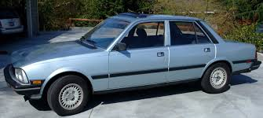
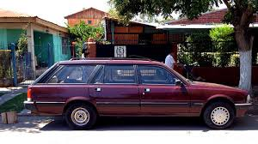
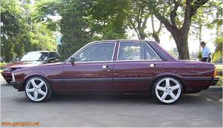
Peugeots
1981
1984
1986
Notes:
A girl was impressed when "the bicycle guy" asked her out and showed up in a Mercedes. We married. I had used my French and German to help friends buy Peugeots in Germany. We bought one, and then when our family grew to three kids, got a bigger one. I learned the truth of the saying, "There are three ways to do anything: the right way, the wrong way, and the French way."

Slide 9
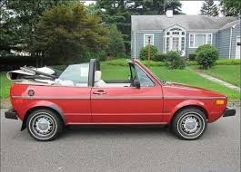
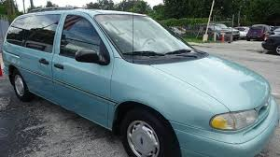
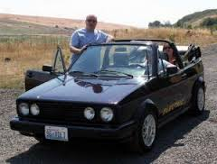
1981 VW Cabrio
1995 Ford Windstar
1986 VW Cabrio
Notes:
The women took over. My wife drove to work, and the baby sitter used the other card to drive the kids around. I couldn't meet new clients on a bicycle!. I bought a VW. Business got better: the VW got better. We later got this large Ford. It took us to the beach, skiing, and to Canada twice.

Slide 10
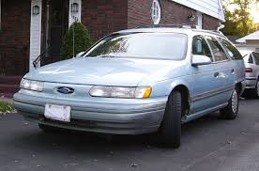
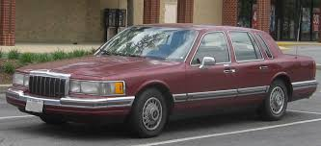
Notes:
The kids needed their own cars. They took the babysitter's 1993 Ford. Teaching my son Jack to drive, it was clear that he needed something safe – this 1992 Lincoln. He had three accidents in three months: He went straight when the road went left. Broke a wheel. Then, the stupid deer just didn't jump out of his way. New headlights. Lastly, he didn't notice trouble ahead. Totally wrecked the car – but he and his sister were OK.

Slide 11
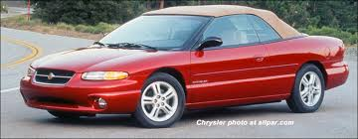
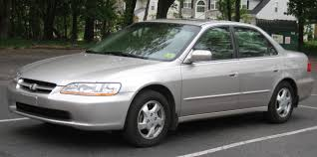
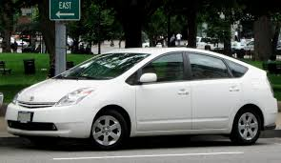
1996 Chrysler Sebring
1998 Honda Accord
2004 Toyota Prius
Notes:
My wife got the cars she liked, and I bought a new convertible to replace the Volkswagens. And I kept on biking.

Slide 12
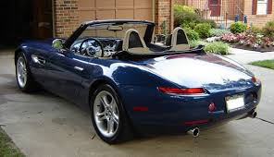
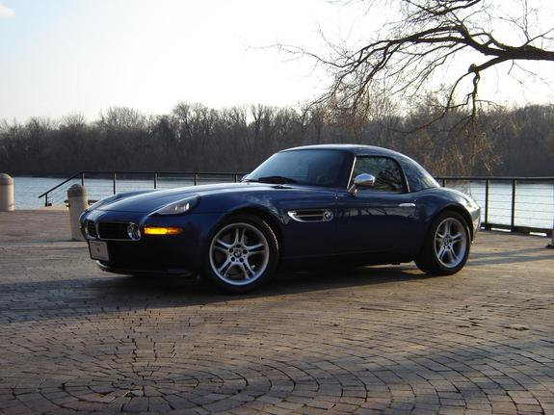
2001 BMW Z8
Notes:
When the kids left home I got a hankering for another nice car. BMW only made 6000 of these Z8s, and very few of them in this color. I flew to Florida and paid too much money to get it. My wife flew down to meet me. She never stopped telling me what a waste of money it was. The kids weren't talking to me, and she wasn't nice to me. I got three cars in the divorce. I sold the Honda and Windstar immediately, and the Z8 when I moved here.

Slide 13
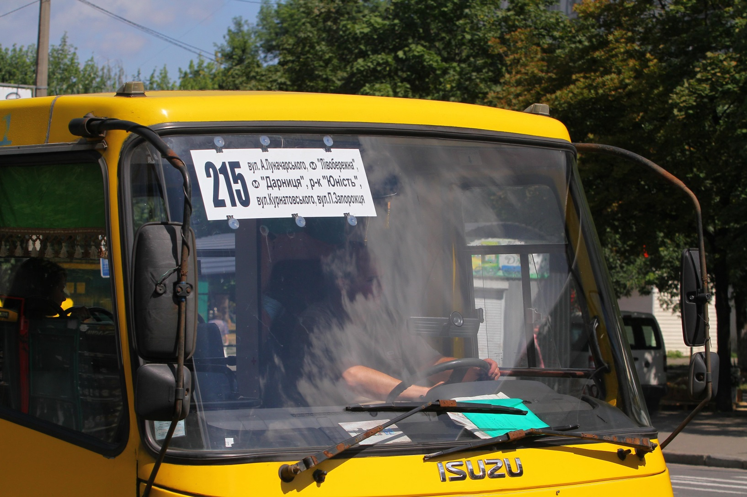
Marshrutka
Notes:
Now I have moved up to a bigger machine. A machine with a chauffeur. I am happy to let other people buy the gasoline, change the tires, keep it fixed and find parking. I have finally concluded what kind of car I need. A marshrutka.
I still bike. And this is the summer that Eddie will get his own bike. Enough of cars!

