Slide 1
Secrets of Internet Secrecy
Graham Seibert
December 2, 2015
Notes:
Good morning I'm taking a risk this morning. I'm going to talk to you general audience about a technical subject. This is a tough assignment. I'm talking about the engine behind Internet security. The thing that makes it possible for you to send credit card information or debit card information over the Internet without somebody stealing your money. This is at the heart of the Internet. Almost everything that you send, even emails, gets encrypted so that other people don't read your mail.

Slide 2
Everything is numbers
Add an encryption key (here, 6 8 11)
And get an encrypted message
Notes:
Everything in the computer is carried as numbers. The word Toastmasters is made up of the numbers the Stanford TO AST and so on they are as you see here 84 ,111, 97, 115 and following.
I can take a cryptographic key to modify those numbers, to turn this easily read text into something that I can more or less secretly send somebody else. In this example the encryption key is pretty simple: the numbers 6, 8, and 11.
The simple rule I'm using here says to add the numbers 6, 8, and 11 to successive characters in the text. You see the 84+6 is 90, 111+8 is 119 , 97+11 is 108.
That results in a new series of numbers. These numbers in turn correspond to characters. These are the characters that you get: Z, W, L, Y, and so on. If I sent this word over the Internet even if you saw it you wouldn't know what it meant. But whoever receives it can use the key, 6, 8 and 11, to subtract back and figure out what the original text was.
There is nothing magic about this. People have been using encryption to send secret messages for thousands of years.

Slide 3
The “key” ingredient is the shared key
Only you and I know it (or our computers!)
Quite long (about 38 decimal digits)
Established on-the-fly
One-time use
Notes:
The key to cryptography is the shared key. The person who creates a message and the person who reads it have to use the same key to encrypt and decrypt a message. The way it works on computers is that our computers cook up the numbers. They are pretty good at making random numbers. Today's standard is 128 bits, about 38 decimal digits. The keys are generally established on the fly for one-time use.
The trick is that the people who want to talk to each other usually cannot meet in person to exchange a cryptographic key. If you want to send a credit card number to an online store, you need to do it right now, and you may never have done business with them before. The way that you do it is called public key cryptography.

Slide 4
Public key cryptography basics
You have a secret number
I have a secret number
There is a shared number passed over the Internet. We assume it is not secret.
Notes:
In public key cryptography my computer has a secret number, your computer has a secret number, and we create a shared number called the public key which we send back and forth. We assume that anybody in the world can see the shared number.

Slide 5
We need to combine the public number with a private number in an Irreversible process
But Use Exponentiation! – logarithms are tough, and not an exact inverse
281²³ = 209,047,682,734,381,552,013,280, 415,
608,595,285,371,404,001,732,212,455,331
But
log₂₈₁209,047,682,734,381,552,013,280, 415,
608,595,285,371,404,001,732,212,455,331 = ????
Not using addition – subtraction is its exact inverse
85340810 + 280919064 = 366259874
but
366259874 - 280919064 = 85340810
Not using multiplication – Division is its inverse
51,924,521 x 6,807,506 = 353,476,488,254,626
but
353,476,488,254,626 / 51,924,521 = 6,807,506
Notes:
To use these we need to be able to combine two numbers to form a third in such a way that it cannot be undone. In other words, given the results and one of the numbers, you cannot figure out the other starting number.
Addition doesn't work, because it can be easily reversed by subtraction. If I give you this number and that one, you can easily subtract to find the missing one.
Multiplication is the same way – division can undo it.
Exponentiation – raising a number to a power – is the solution. The inverse is a logarithm. Logarithms are hard to undo, and the numbers are only approximate. If you start to throw away some parts of the product as the numbers get very large, as you see here, it makes it impossible to unravel. Exponentiation is at the heart of combining numbers in such a way that they cannot be taken apart.

Slide 6

Paint mixing is a good metaphor – you cannot unmix paint
My color Your color Public color
Notes:
Paint mixing is a great metaphor for public key cryptography. You cannot unmixed paints. If I give you two colors, you can put them together, but if I give you a mixture and one of the original colors, you cannot go backwards to figure out the other original color. So I'm giving you this colorful example of how public-key cryptography works. My color is my secret number, your color is your secret number, and the public color is the public key.

Slide 7
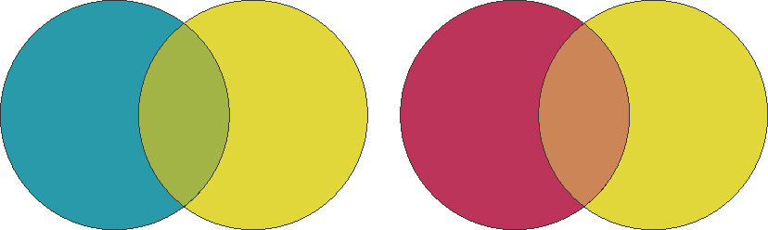
Mix with the public color in our own secret lab (computer)
Mine plus public Yours plus public
Notes:
Your computer and my computer both have access to the public key,. I make a mixturescombining my number and the public key, and you make a combination of your number and the public key.

Slide 8

Make just the mixes available over the Internet
Public Mine + public Yours + public
Big clue – they all contain the public color
Notes:
I send my combination to you, and you send your combination to me by the Internet. We assume that anybody in the world can read them, but we don't care.

Slide 9
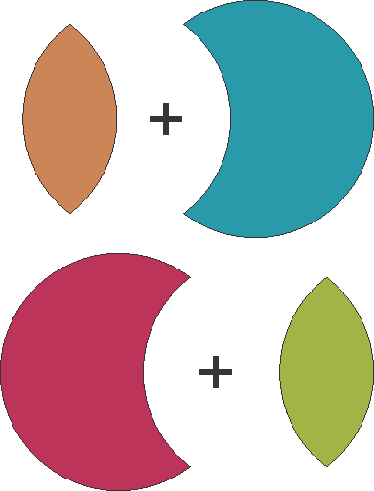
I take your mix, you take mine and we add to our own secret color
Your mix plus my secret color
My mix plus your secret color
Notes:
Now comes the magic. I mix what I got from you – your color plus the public color, and you mix your color plus the mix you got for me.

Slide 10


And we get the same thing!
Our shared secret color
Notes:
We both come up with the same color! That color contains the two secret colors plus the public color.

Slide 11
Which nobody else can get because they don’t have our pure colors
Everything they have contains the public color, which they cannot get rid of
Notes:
Nobody else can create the mixture because they don't have access to a pure color. In this example, every color they have has yellow in it, and there is no way to get the yellow out.

Slide 12
Think 38-digit numbers instead of colors, and we have created
A key that only you and I know
A throw-away key, good for one session only
Encryption that is so difficult to break that all governments are afraid of it
Notes:
So now, think about 38 digit numbers in place of those colors. You and I have a secret 38 digit number that both of us know and nobody else can figure out. That is our cryptographic key. We can use it to encrypt and decrypt messages to each other,
More than that, it is so easy to set up that we can use it one time and throw it away. Even if somebody takes the trouble to figure it out, all they can do is read one message.
This encryption is so difficult to break that governments are scared to death of it. The United States government worries that terrorists use encrypted messages to plan their attacks.

Slide 13
Public Key Cryptography
Is at the heart of all secure Internet communications
Is used to protect files stored on local computers
Is essential to digital currencies, like Bitcoin
Notes:
So that's how public-key cryptography works. It is at the heart of all secure Internet communications, and it is also used to password protect files you store on your computer. It is absolutely essential to digital currencies like Bitcoin. That's going to be the topic of my next talk – how digital currencies work, why they are a threat to national currencies like the hryvnya and the dollar, and why you are certain to see more of them in the future.
I hope that that wasn't too complex for you. I have to concede that it took me several times through before I understood this public-key cryptography business. I have posted this PowerPoint on my website among my Toastmasters speeches. If you're curious you can download it and go through it again. Madame ToastMaster.

