Slide 1
Global Warming on a Coffee Break
Graham Seibert
Notes:
I am a skeptic. As the alarm about global warming became stronger, and the proposals to control it more invasive, I decided to study the issue. I have a strong background in computers, statistics and science. It seemed that the strongest advocates of global warming were the ones who benefitted from it. They have highly paid jobs and investments. They have fervent believers, like a religious cult – groupies who cannot whatsoever explain the science behind the threats they find so fearful.
Being skeptics brings us no benefits. We get attacked, ridiculed and fired for giving our opinions. Nonetheless, many brave climate scientists have changed their minds and written books about why the fear is overblown. I have read the books. They are credible.
There is nothing in it for me being a skeptic except making a better world for my grandchildren. I don't want the planet to be destroyed. I also do not want to see my grandchildrens' lives controlled by totalitarians.

Slide 2





The Theory
Oxygen
Nitrogen
Carbon Dioxide
Methane
Notes:
2 It is based on a theory – correct as far as it goes. Sunlight arrives during the day. Since it has a short wavelength, it passes through the Earth's atmosphere without warming it up. It heats the Earth's surface.

Slide 3


The Theory
CO2 has gone from 280 parts per million to 400. It is headed towards 450
Oxygen
Nitrogen
More heat will be absorbed
Carbon Dioxide
Carbon Dioxide
Methane
Methane
Notes:
The earth re-radiates heat at night.
The wavelength is much longer,
and carbon dioxide absorbs the heat.
Since the amount of carbon dioxide
in the air is increasing, more heat is captured.
This is the primary theory about global warming. While valid, it downplays other factors.

Slide 4




The United Nations
Money
Guilt
UN Votes
Poverty and claims
Raw Materials and pollution
Slavery and colonialism
Global Warming
Notes:
Since it is a global problem, the United Nations
took the lead in dealing with it.
The UN is a confederation of 193 countries,
about 35 of them rich, the rest not so much.
The politics have always had money flow
from the rich with guilty consciences
to the poor with abundant needs.
The excuses have been the history
of slavery and colonialism,
the exploitation of raw materials, pollution and environmental damage. Global warming fit right in;
the rich countries are melting the ice caps,
and the poor countries will drown.
Some UN officials have been so indiscreet as to state openly that their mission is global income redistribution.

Slide 5




The UN Climate Bureaucracy
Advice
Advice
Intergovernmental Panel on Climate Control
Notes:
The United Nations set up a climate bureaucracy called the Intergovernmental Panel on Climate Control. Participants include climate experts from research institutions around the world.
UN members fund the IPCC and provide advice. The IPCC in turn gives funding and advice to research institutions. This gives them powerful control.
Many bureaucrats are involved at the UN level and various donor countries. Their handsome salaries depend on global warming being real.

Slide 6





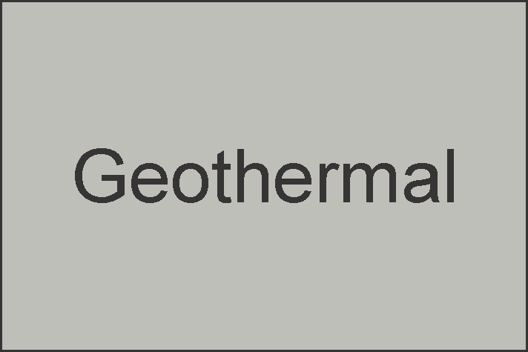



Computer Model
Contributors
Seeded components
Shared ideas
Computer power
Warning!!!
Complexity Ahead
Inputs
Temperature
Wind
Moisture
Vegetation
Ocean temp
Ocean currents
Cloud cover
Population
Wealth
Technology
Sun Spots?
Cosmic Rays?
Ignore the details!
Output
Temperatureprojections
Notes:
Determining what is going to happen to the climate requires the most complex computer model ever devised. It is so complex that no research facility could possibly develop a model from scratch. They all have to use a number of components developed elsewhere. The IPCC distributes components, which assures that its point of view is well represented in most of them.
Collecting inputs is a very expensive worldwide effort. The IPCC coordinates standards for data measurement and collection. All of the data is held in common. All models use more or less the same data.
The list shown on the slide barely scratches the surface of the measurements that go into the model or the modules that make it up. It is hugely complex.
The major outputs are an estimate of what temperatures have been, and what they are going to be.

Slide 7
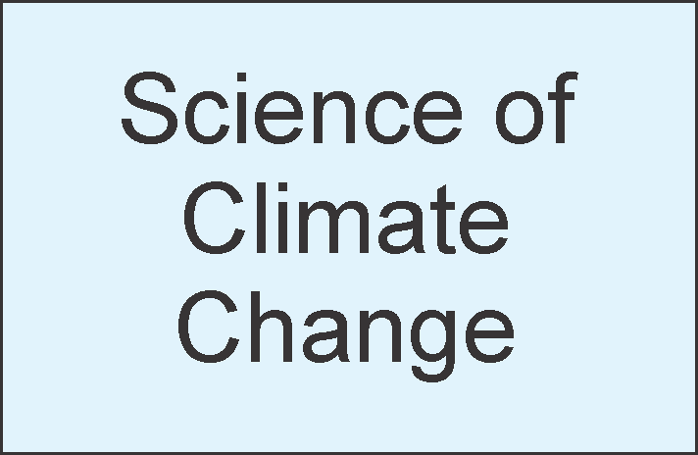
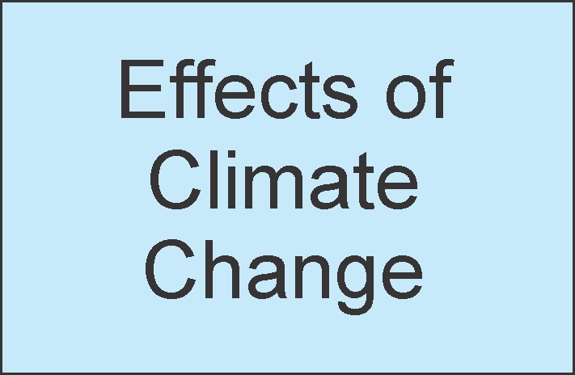
















IPCC Structure
Notes:
The IPCC is organized in a 3 x 3 structure. Functionally, there is the science of climate change – what causes it and how to measure it. A second functional group estimates the damage caused by global warming. The third group develops policy for what to do about it.
All three functions are performed at three levels. At the working level scientists develop papers. Editors right technical summaries for the scientists to share. Lastly, the IPCC produces executive summaries for the public and the press.
At the working level this 3 x 3 matrix is mostly staffed by physical scientists -- physicists, ecologists and others. At the next level, there are technical writers and political scientists.
At the summary level, producing information for the public and the press, you have Greenpeace. Or, you used to have Greenpeace – at the time of Kyoto. This resulted in some embarrassment. They claimed for instance that the glaciers in the Himalayas would melt by the year 2035. The scientists said "we didn't say that." .
A young University of Massachusetts scientist named Michael Mann managed to get the infamous "hockey stick" graph included in the 2001 report, with the campaign slogan "its hotter now than the last 1000 years!“, and “1998 was the hottest year for a 1000 years!” Al Gore even exaggerated the "hockey stick" in his movie "An Inconvenient Truth." The IPCC eventually backed down, but when the fraud was uncovered the damage to the IPCC's credibility was lasting.
The IPCC has reduced the presence of Friends Of The Earth and Greenpeace, but the people who write the executive summaries are still advocates.

Slide 8




Other Factors
Sun
More clouds mean less heat
Spot
Human activity and sun spots
Affect cloud cover
Cosmic Rays
More
Cloud
Cover
More heat reflected back
Dirt Particles
Notes:
There are other factors involved in global warming. When there is more cloud cover there is less warming – radiation gets reflected back into space. More clouds less heat. Major reasons for there being more clouds are first, dirt. More dirt in the atmosphere provides more opportunity for water vapor to condense. You have all seen the vapor trails left by airplanes. You are familiar with smog.
The earth’s tilt changes on a 25,000 year cycle. Its seasonal orientation changes on a 40,000 year cycle. Its distance changes. These significantly affect the amount of solar radiation, contributing to the variation shown in the next slide.
Another source of cloud cover is cosmic rays. Cosmic rays ionize molecules in the atmosphere, around which clouds can form. More cosmic rays, more clouds, less heat. Cosmic rays are related to sunspots: fewer sunspots, more cosmic rays.
A Dane named Svensmark developed this theory. He needed the nuclear collider in Switzerland to test it. The IPCC blocked access for several years. When he finally got permission, lo and behold, the theory was true.
Solar activity – sunspots – go in cycles. So does the earth's temperature, much more than the IPCC model showed.

Slide 9

Factor: Volcanos spew ash and
CO₂ into the air
Ash makes more cloud cover – short-term cooling
CO₂ leads to long term warming

Slide 10


Factor: Earth’s Axis Tilt changes
Warming in high latitudes

Slide 11

Factor: Distance from sun changes

Slide 12
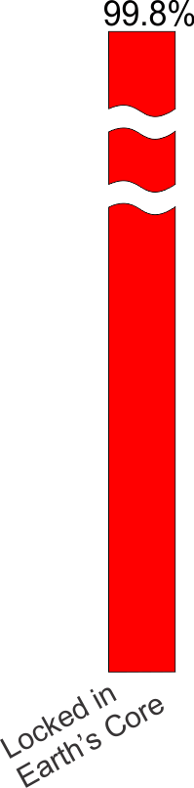
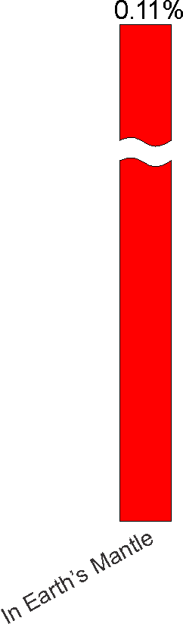
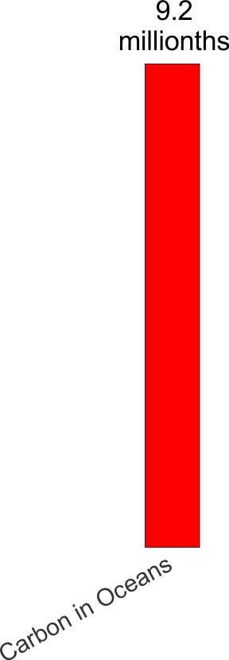
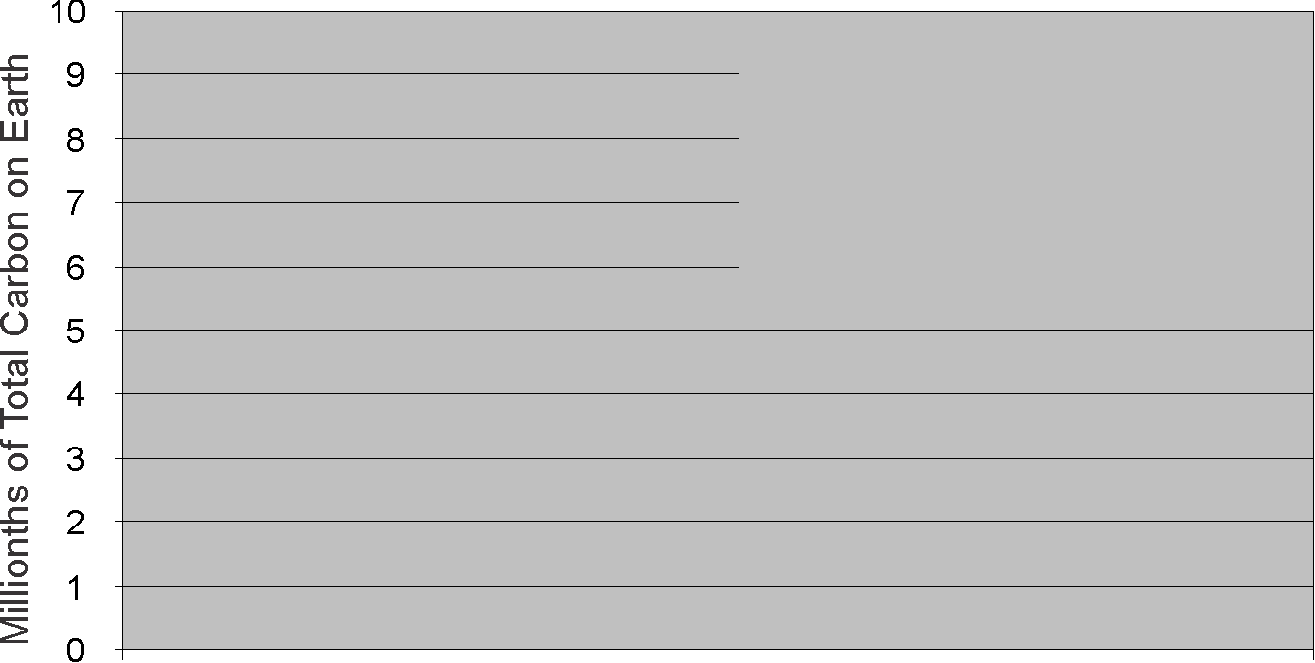

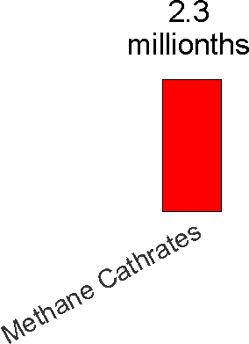
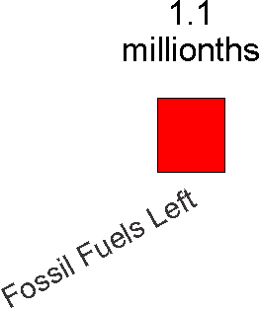
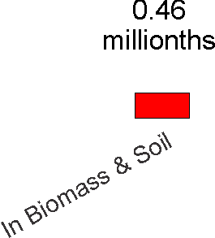
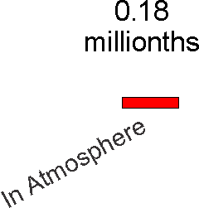
Where is the
Earth’s Carbon?

Slide 13

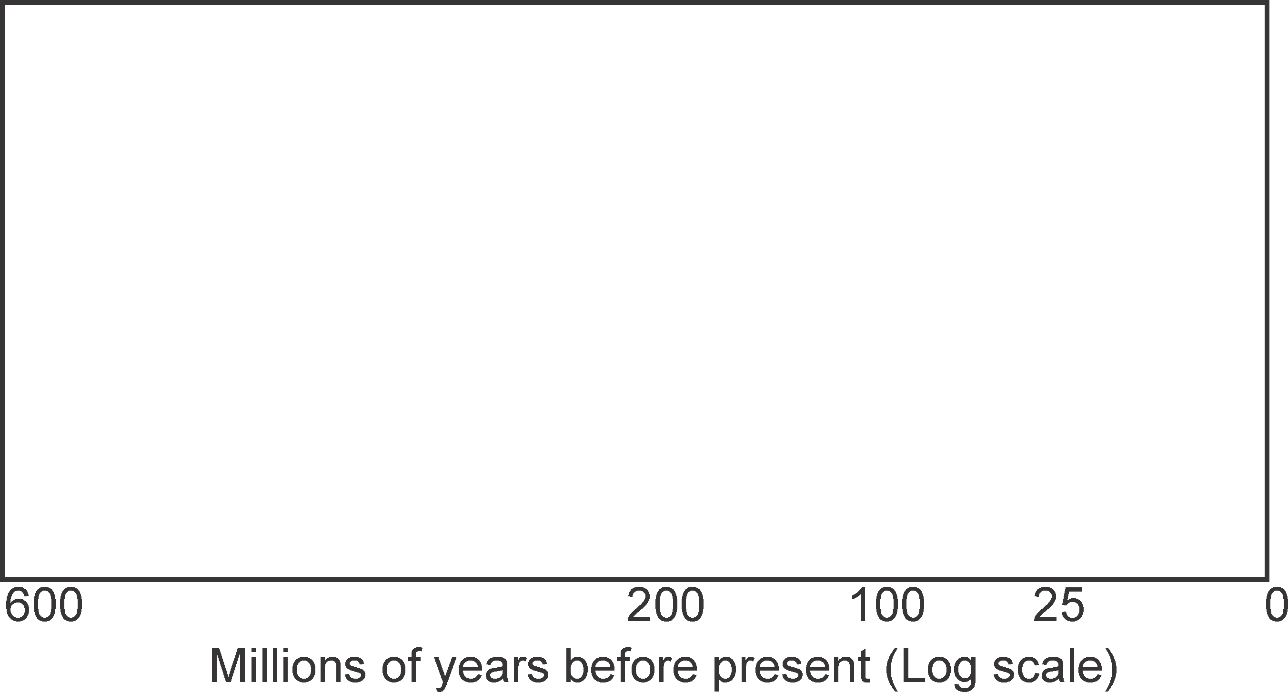
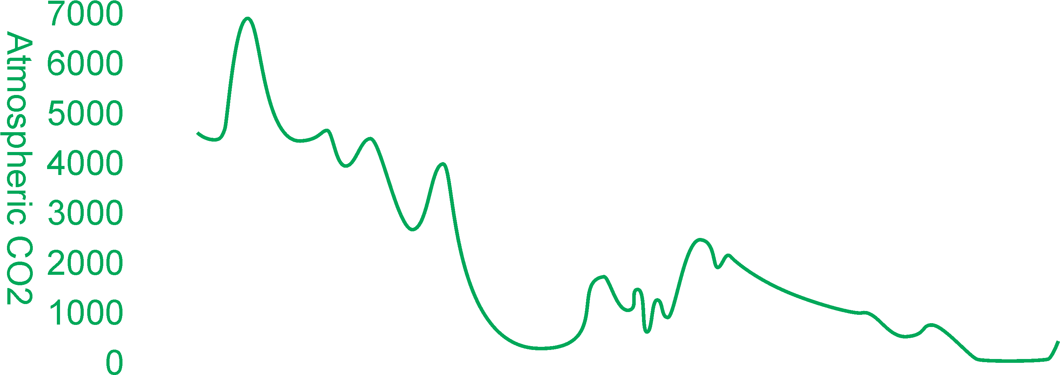
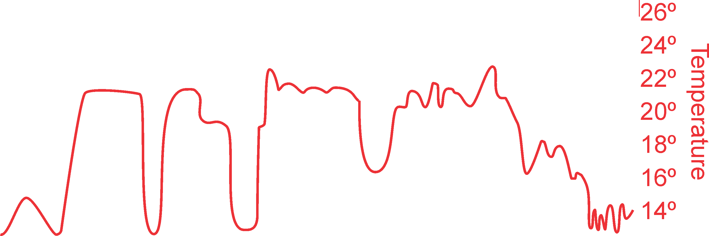


CO₂ and Temperature in Geological History
Not much correlation!
Notes:
Let's go back in geological history. When the earth was young, the sun was 30% weaker – but the earth didn’t freeze. When it was 85% as old as today, the sun had warmed almost to today’s level – but the earth had become a giant snowball! There are many factors at work.
600 million years ago, in the age of the trilobites, before life on dry land, carbon dioxide was 20 times higher. It was 10 times higher in the age of the dinosaurs. Since man has been on earth it is been between 180 and 280 ppm. However, since the industrial age, it has crept up to 400 ppm and is headed higher.
How they know, and how confident the scientists are, is a fascinating topic. They measure isotopes, analyze ancient sea beds for glacial activity, measure the calcium in ancient sea animals and rates of chemical reactions long ago.
Temperature over this period has gone up and down, but it seems to be right about where it started. Temperature did go up in the 1980s and 1990s – not as much as the alarmists said – but it did make global warming a serious question. However, since 2000 temperatures have pretty much stayed put, rising only 1/10 of 1° as carbon dioxide has gone up another 8%. There does not seem to be that much correlation between atmospheric carbon dioxide alone and temperature. It makes sense – there is a million times more carbon on earth than the small fraction in the air, biomass and fossil fuels. Other factors are at play.

Slide 14

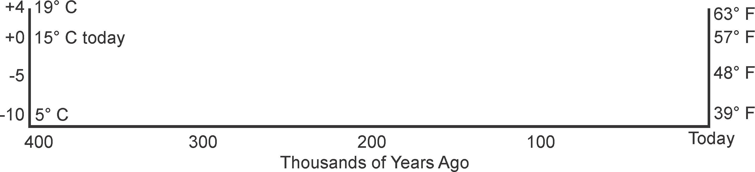
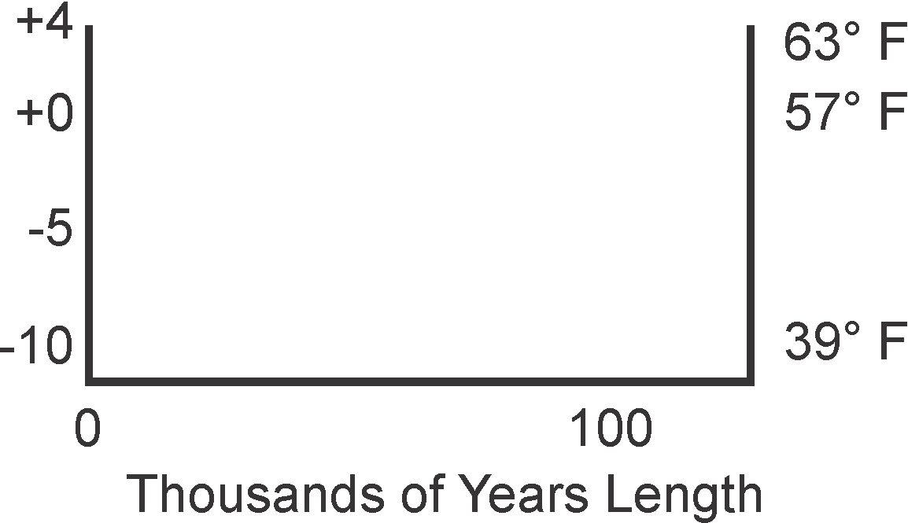
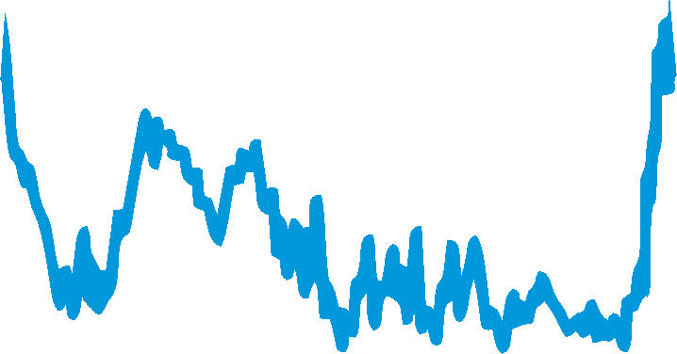
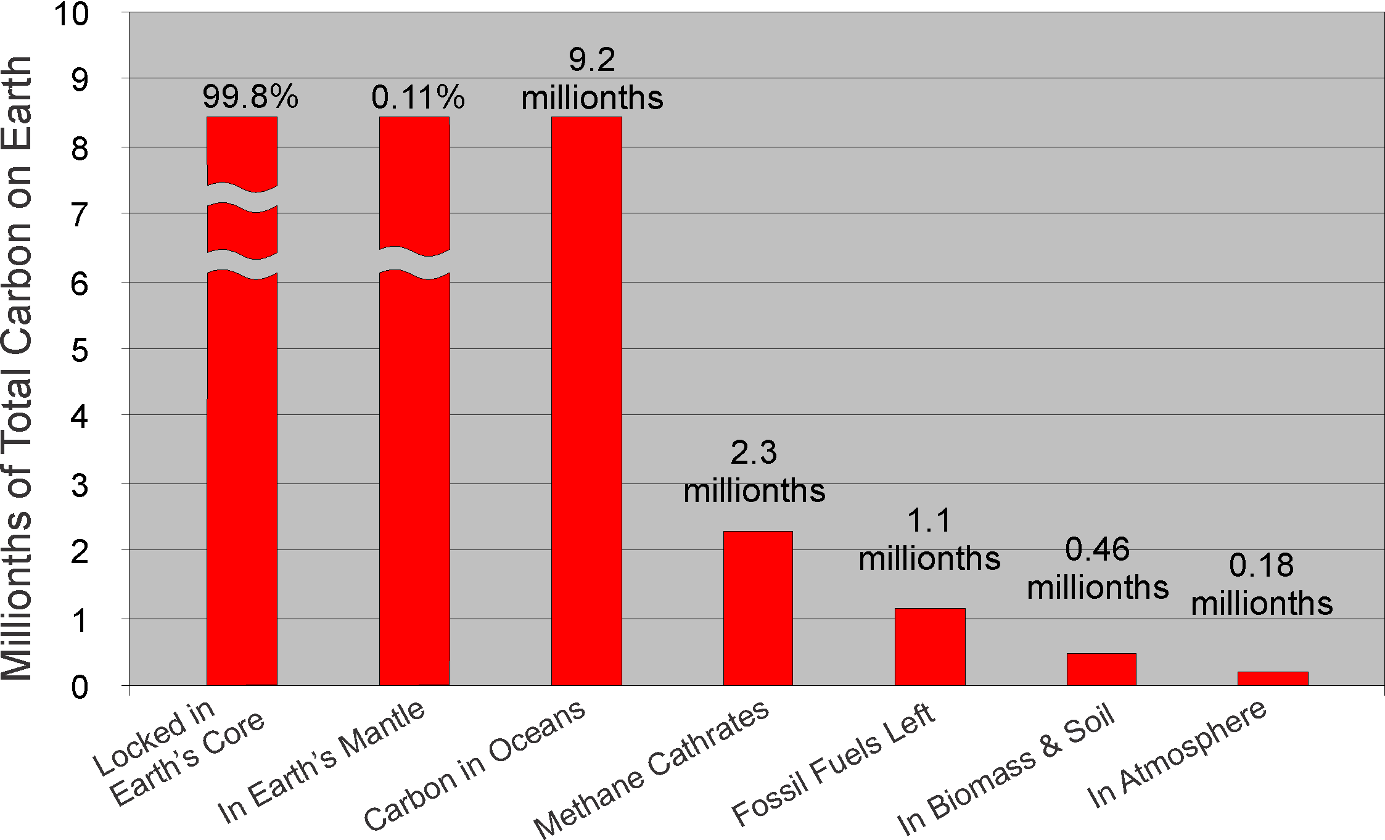
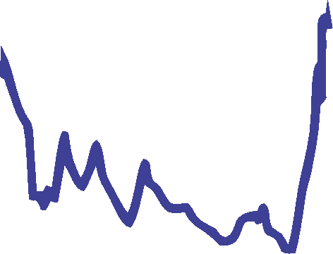
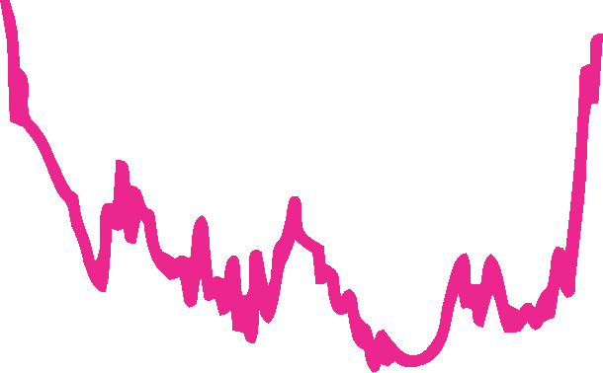
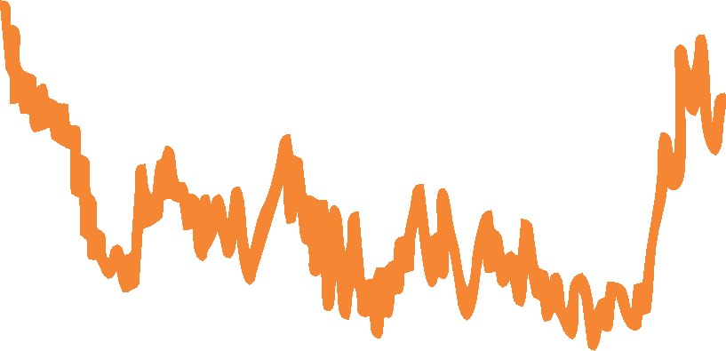
Ice Age Temperatures
Temperature would rise by 5°C
IPCC Formula: Temperature rises 2.5°C for every doubling of CO₂
If we burned all remaining fossil fuels
20° C
15° C today
10° C
5° C

Slide 15
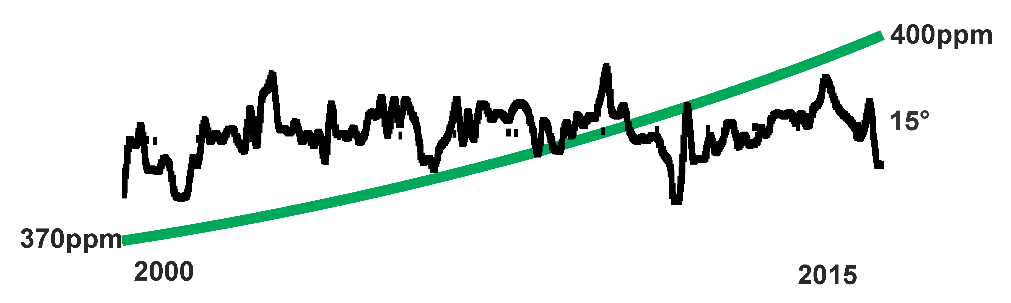
History of Science
Global warming meme 30 years old
Climate science has advanced greatly
Vast investment in the Global warming meme
Since 2000 - CO₂ up 8%, temperature hardly at all

Slide 16
Diplomacy
Kyoto 1997
Copenhagen 2009
Paris 2015
Serious Attempt
Not so serious
Promises, promises
Notes:
The diplomacy reflects this. Back in 1997, at the Kyoto conference, many countries made a serious attempt to cut carbon emissions. The Europeans Japanese were quite successful. They cut fossil fuel use and increased solar and wind power. The United States and China were not so serious about it.
By the time of the Copenhagen conference in 2009 they were not so serious. Climate activists were disappointed that there were no binding agreements.
By the 2015 Paris conference they set their sights much lower. They were willing to accept national promises to continue to do their best. The only firm commitment was to continue the process – to keep those bureaucratic salaries coming.

Slide 17
Beneficial Results
Spurred development of renewable energy
  Solar
  Wind
Slowed deforestation
Spotlight environmental damage
  Tar Sands
  Shale Oil / Fracking
  Mountaintop Removal
Maybe prevented some global warming?
Notes:
The concern about global warming is had several beneficial effects.
It has spurred the development of renewable energy such as solar and wind.
Brazil and African countries have taken measures to slow deforestation, a good environmental result.
World attention focused on the environmental damage that fossil fuels are doing. Extracting oil from tar sands in Canada, and shale in the United States, is environmentally messy. Likewise the process of mountaintop removal in order to mine coal devastates all regions. The world needs alternatives.
Lastly, there is a chance that the global warming frenzy did slow global warming. We do not know for sure what would have happened to temperatures if carbon levels had risen more.

Slide 18
The Future
Rich country populations will shrink (and China)
Self-driving cars:
  Less weight
  Less sex appeal
  More shared use
Better heating, lighting and industrial
Resurgence of nuclear (???)
23%
42%
Don’t Panic
Do cut fossil fuel use, but…
Notes:
We are coming up with self-driving cars. Big impact! Because most of the weight of a car is protection, in case of accidents, we can make them lighter. Makethem have less sex appeal, make them shared use, and make better trucks.
Transportation acccounts for 23% of energy use. That can come down!
We have much better light blubs than we did ten years ago. They are about seven times more efficient.
The insulation in my new house is probably three times more efficient than that in your old apartment.
Heating and lighting account for 42% of energy use.
Lastly, there is a resurgence of interest in nuclear power, which is environmentally very clean.
There are more nucear power plants on the drawing board than there have been for 25 years
So, bottom line, we should cut fossil fuel use for any number of reasons, but
We shouldn't panic. We're not going to drown tomorrow.

Slide 19
Afterword
I am a retired computer programmer, entrepreneur and computer book author. In retirement I have studied statistics and have read sufficiently extensively to be a top 500 Amazon reviewer. I have lectured at the university level on ecology and read extensively on climate change. Here are links to some useful books I have reviewed on Amazon:
Whole Earth Discipline by environmentalist Stewart Brand,
A Vast Machine by Paul Edwards,
Global Warming Gridlock by David Victor.
The Neglected Sun – Why the Sun Precludes Climate Catastrophe by Fritz Vahrenholt and Sebastian Luening,
Climate Change Reconsidered by S. Fred Singer,
Unstoppable Global Warming: Every 1,500 Years by S. Fred Singer, and
Losing Control: The Emerging Threats to Western Prosperity by Stephen King,
Paleoclimate (Princeton Primers on Climate)
These are important names in the field. Google also Roger Pielke, who is much in the news now as he speaks out about how the IPCC-inspired establishment, including media executives, have conspired to shut him up. Google John J. Bates, formerly of NOAA, about how that organization faked data.
See references at www.grahamseibert.com/Climate

